Slide 1
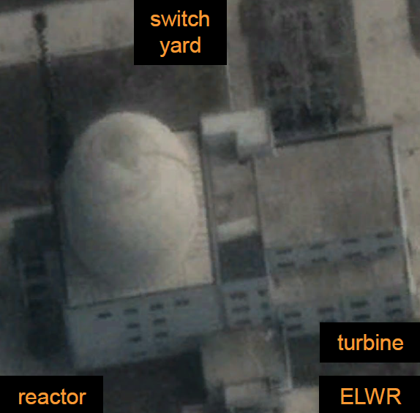
Guess this Pokémon

Slide 2
My opinion of
Least likely → Most likely
Overview of ELWR Parameters Considered
Reference design basis?
VVER-440 (b) VVER-640/1000 (c) KSNP OPR-1000 (KEDO)
Fuel Composition
UO2 ceramic (b) UO2/Al dispersion
Follow-up question, where did NK get UO2 ceramic tech knowledge?
UO2 ceramics mature + easy to make ←→ Sig Hecker quote that NK can’t produce ceramic fuels
(i) Imported from China/Russia/etc.
(ii) Domestically produced, Lead Test Assembly tested in IRT-2000 or 5 MWe YTR1
(iii) Domestically produced, LTA testing in ELWR
3. Reactor purpose/configuration
(a) All UO2 = for power + possible but inefficient WGPu production
(b) UO2 seed + nU blanket = for power + WGPu production
(c) UO2 seed + Li blanket = for power + T production

Slide 3
Structural / Construction
 | Ceramic (Powder compressed + sintered) | Dispersion (fuel particles in metal matrix) or Inert Matrix (fuel particles in INERT matrix, can be any combo of: Cermet, Cercer, Metmet, Metcer) | Monolithic
Oxides (UxOy, MOX) | UC, UN, UO2 | UC, UN, UO2 Cermet: UO2/Mg Cercer: UO2/BeO, UO2/MgO | UC, UN, UO2
Metals (Alloys: U-Zr, U-xMo | Single-Phase: U6Ni, U6Fe, U3Six) | N/A | U-9Mo/Mg, U-xMo/Al | U3Six, U-xMo
Material Composition

Slide 4
TRL = technological readiness level
Very mature, TRL 9 in US/EU/EA
Under development,
TRL 5-7 in US/EU/EA
For power rxrs
For research / test rxrs
For high performance RTRs
 | Ceramic (Powder compressed + sintered) | Dispersion (fuel particles in metal matrix) or Inert Matrix (fuel particles in INERT matrix, can be any combo of: Cermet, Cercer, Metmet, Metcer) | Monolithic
Oxides (UxOy, MOX) | UC, UN, U3O8, UO2 | UC, UN, UO2 Cermet: UO2/Mg Cercer: UO2/BeO, UO2/MgO | UC, UN, UO2
Metallic (can be Alloys: U-Zr, U-xMo Or Single-Phase: U6Ni, U6Fe, U3Six) | N/A | U-9Mo/Mg, U-xMo/Al | U3Six, U-xMo

Slide 5
What reactor fuels does NK have? < > = best guess, uncomfirmed
Reactor | MWe / MWth | Fuel | Enrichment %
IRT-2000 | N/A / 8 | UO2/Al dispersion
Yongbyon No.1 | 5 / ? | Magnox nU metal | 0.7 (natural)
Yongbyon No.2 | 50 / ? | Magnox nU metal | 0.7
Taechon | 200 / ? | Magnox nU metal | 0.7
ELWR | <25> / 100 | <UO2 ceramic> | <3.5>
What reactor fuels might NK have encountered?
Reactor (Origin) | MWe / MWth | %enrich, Fuel | Notes
VVER-440 (USSR) | 440 / | UO2 ceramic | Deal signed 12/1985, halt after Chernobyl 04/1986
VVER-640 (USSR) | 640 / | UO2 ceramic | Deal signed 12/1991, halt after NK non-pay 04/1992
KSNP / OPR-1000 (KEDO) | 1000 / | UO2 ceramic | 1994-2003, actual construction began, NK ROs trained

Slide 6
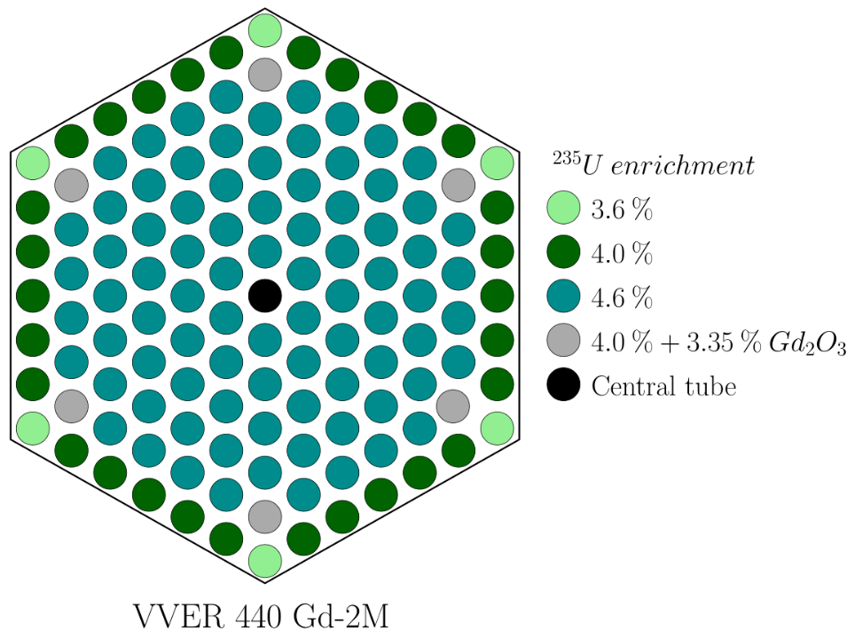
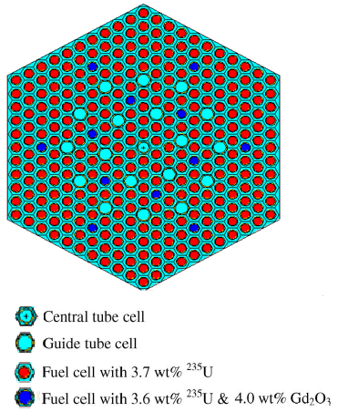
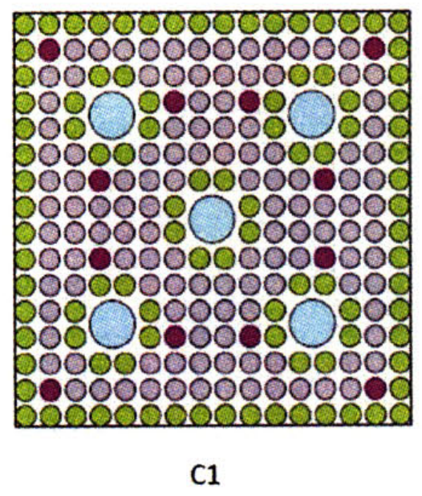
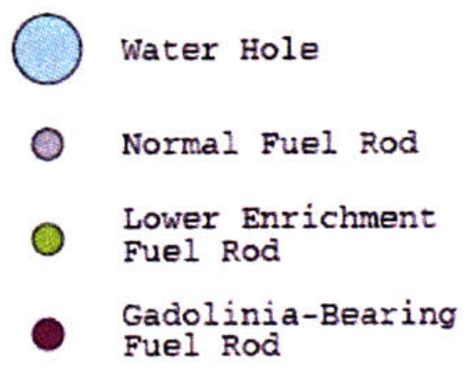
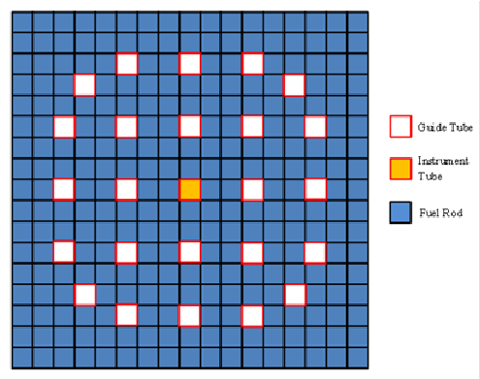
VVER-640/1000
OPR-1000 16x16
Westinghouse PWR 17x17

Slide 7
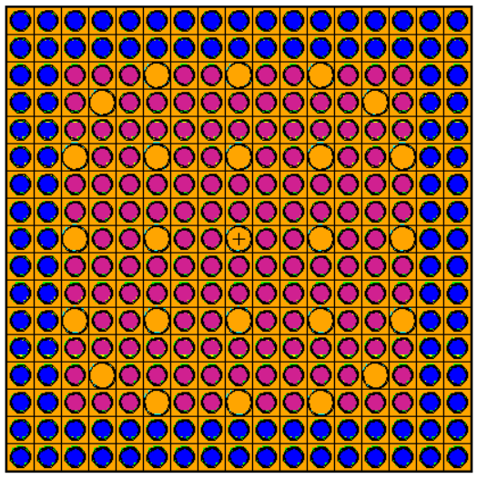
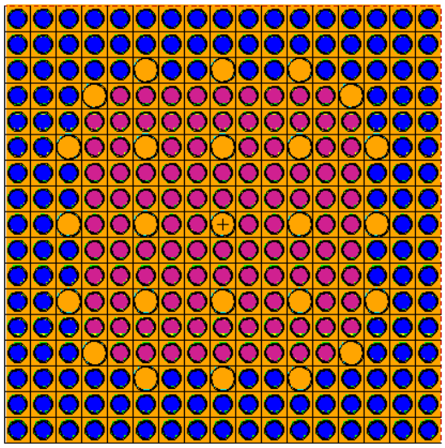
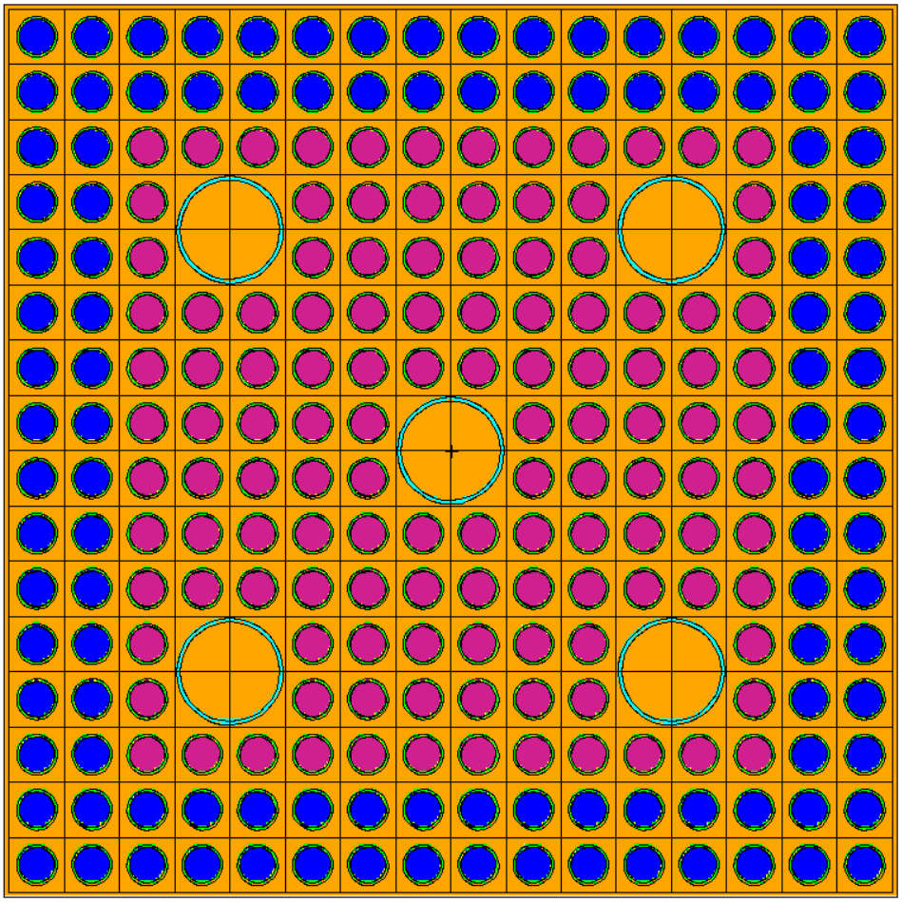
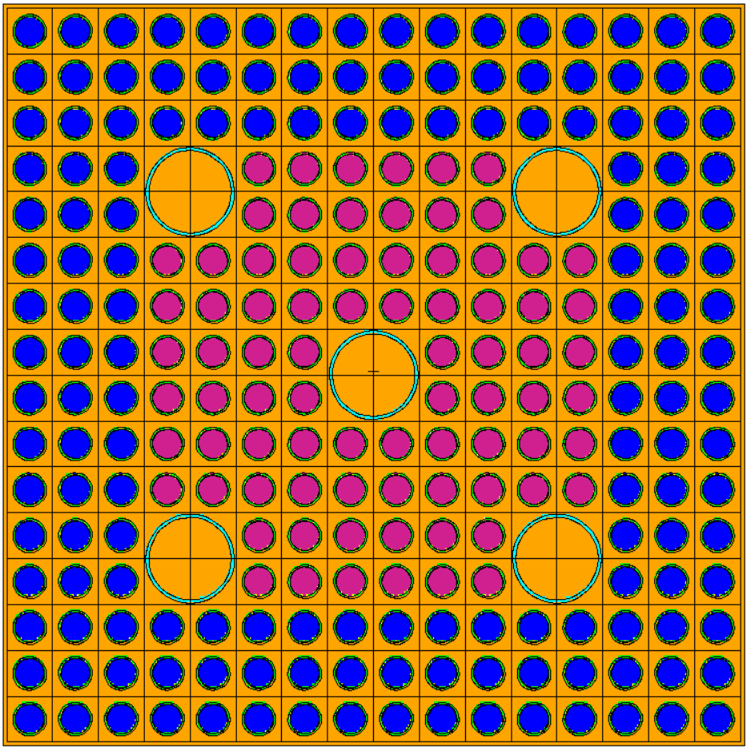
after 167 days
of full power ops
7.43 kg WGPu
10.02 kg WGPu
AP600 17x17 FA
OPR1000 16x16 PLUS7 FA

